Slide 1
Mobile Programming with Android Ch 01 Introduction
Charisma Tubagus S

Slide 2
What is Android?
Android is an open source and Linux based Operating System for mobile devices such as smartphones and tablet computers
Android was developed by Open Handset Alliance led by Google and other companies
The first version of Android SDK was released in 2007, whereas the first commercial version Android 1.0 was released in September 2008
The source code for Android is available under free and open source software licenses
The current version of Android is 7.0 Nougat, released in August 2016.

Slide 3
Android Features
Feature Name | Description / Detail
Beautiful UI | Android OS basic screen provides a beautiful and intuitive user interface
Connectivity | GSM/Edge, IDEN, CDMA, EV-DO, UMTS, Bluetooth, Wi-Fi, LTE, NFC, and WiMax
Storage | SQLite, a lightweight relational database, is used for storage purpose
Media Support | H.263, H.264, MPEG-4 SP, AMR, AMR-WB, AAC, HE-AAC, AAC 5.1, MP3, MIDI, Ogg Vorbis, WAV, JPEG, PNG, GIF, and BMP
Messaging | SMS and MMS
Web Browser | Based on open source WebKit layout engine, coupled with Chrome’s V8 Javascript engine supporting HTML 5 and CSS3
Multi Touch | Android has native support for multi touch which was initially made available in handsets such as HTC hero
Multi Tasking | User can jump from one task to another and same time various application can run simultaneously

Slide 4
Android Features
Feature | Description / Detail
Resizable Widgets | Widgets are resizable whether to expand or shrink
Multi Language | Support single direction and bi-directional text
GCM | Google Cloud Messaging is a service that let developers send short message data to their users on android android devices, without needing a proprietary sync solution
Wi-Fi Direct | A technology that let apps discover and pair directly
Android Beam | A popular NFC based technology that let users instantly share just by touching two NFC enabled phones together

Slide 5
Android Version History
Code Name | Version Number | Release Date | API Level
(no code name) | 1.0 | September,2008 | 1
Pettit Four | 1.1 | February, 2009 | 2
Cupcake | 1.5 | April, 2009 | 3
Donut | 1.6 | September, 2009 | 4
Éclair | 2.0-2.1 | October 2009 | 5-7
Froyo | 2.2-2.2.3 | May, 2010 | 8
Gingerbread | 2.3-2.3.7 | December, 2010 | 9-10
Honeycomb | 3.0-3.2.6 | February, 2011 | 11-13
Ice Cream Sandwich | 4.0-4.0.4 | October, 2011 | 14-15
Jelly Bean | 4.1-4.3.1 | July, 2012 | 16-18

Slide 6
Android Version History
Code Name | Version Number | Release Date | API Level
Kitkat | 4.4 – 4.4.4 | October 2013 | 19-20
Lollipop | 5.0 – 5.1.1 | November 2014 | 21-22
Marshmallow | 6.0 – 6.0.1 | October 2015 | 23
Nougat | 7.0 – 7.1.2 | August 2016 | 24 - 25

Slide 7
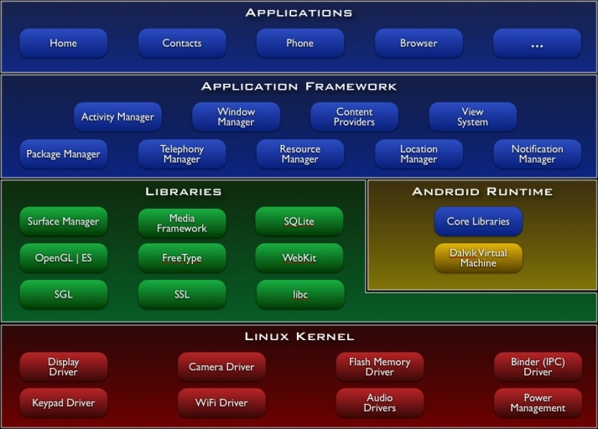
Android Architecture

Slide 8
Android Architecture
Applications
Android will ship with a set of core applications including an email client, SMS program, calendar, maps, browser, contacts, and others. All applications are written using the Java programming language
Application Framework
By providing an open development platform, Android offers developers the ability to build extremely rich and innovative applications. Developers are free to take advantage of the device hardware, access location information, run background services, set alarms, add notifications to the status bar, and much, much more.
Developers have full access to the same framework APIs used by the core applications. The application architecture is designed to simplify the reuse of components; any application can publish its capabilities and any other application may then make use of those capabilities (subject to security constraints enforced by the framework). This same mechanism allows components to be replaced by the user.
Underlying all applications is a set of services and systems, including:
A rich and extensible set of Views that can be used to build an application, including lists, grids, text boxes, buttons, and even an embeddable web browser
Content Providers that enable applications to access data from other applications (such as Contacts), or to share their own data
A Resource Manager, providing access to non-code resources such as localized strings, graphics, and layout files
A Notification Manager that enables all applications to display custom alerts in the status bar
An Activity Manager that manages the lifecycle of applications and provides a common navigation backstack

Slide 9
Android Architecture
Libraries
Android includes a set of C/C++ libraries used by various components of the Android system. These capabilities are exposed to developers through the Android application framework. Some of the core libraries are listed below:
System C library - a BSD-derived implementation of the standard C system library (libc), tuned for embedded Linux-based devices
Media Libraries - based on PacketVideo's OpenCORE; the libraries support playback and recording of many popular audio and video formats, as well as static image files, including MPEG4, H.264, MP3, AAC, AMR, JPG, and PNG
Surface Manager - manages access to the display subsystem and seamlessly composites 2D and 3D graphic layers from multiple applications
LibWebCore - a modern web browser engine which powers both the Android browser and an embeddable web view
SGL - the underlying 2D graphics engine
3D libraries - an implementation based on OpenGL ES 1.0 APIs; the libraries use either hardware 3D acceleration (where available) or the included, highly optimized 3D software rasterizer
FreeType - bitmap and vector font rendering
SQLite - a powerful and lightweight relational database engine available to all applications

Slide 10
Android Architecture
Android Runtime
Android includes a set of core libraries that provides most of the functionality available in the core libraries of the Java programming language.
Every Android application runs in its own process, with its own instance of the Dalvik virtual machine. Dalvik has been written so that a device can run multiple VMs efficiently. The Dalvik VM executes files in the Dalvik Executable (.dex) format which is optimized for minimal memory footprint. The VM is register-based, and runs classes compiled by a Java language compiler that have been transformed into the .dex format by the included "dx" tool.
The Dalvik VM relies on the Linux kernel for underlying functionality such as threading and low-level memory management
Linux Kernel
Android relies on Linux version 2.6 for core system services such as security, memory management, process management, network stack, and driver model. The kernel also acts as an abstraction layer between the hardware and the rest of the software stack.

Slide 11
Android Application
There are many types of android application available at Play Store:
Chat application : telegram, line, whatsapp, bbm, facebook messenger
Games: mobile legends, clash of clans, etc
Web browser: chrome, firefox, opera
Multimedia: video player, music player
Utility: baidu, turbo boost
Document viewer: pdf viewer, doc viewer, ppt viewer
And many more

Slide 12
Environment Setup
For developing android application, you’ll need 2 things, namely Java JDK and Android Studio.
The current version of Java JDK is 1.8
The current version of Android Studio is 2.3.3
The Java JDK can be downloaded at Oracle website
The Android Studio can be downloaded at https://developer.android.com/studio/index.html?hl=id

Slide 13
Installing Java JDK
After you download Java JDK, from Oracle website, you need to execute / double click the program to start the installation process
Leave the default option and click Next several times
After installing the Java JDK, you’ll need to setup environment variables
The environment variables can be looked up in System Properties
You need to add new variable called JAVA_HOME and points its location to the Java JDK installation directory
After that, you’re done installing Java JDK

Slide 14
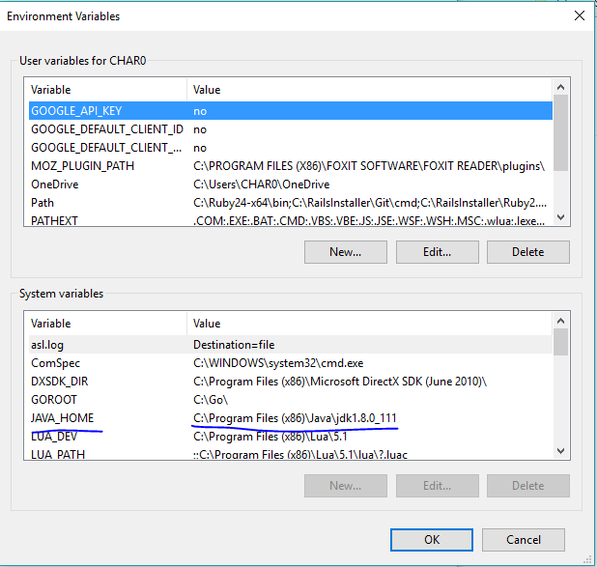
Installing Java JDK

Slide 15
Installing Android Studio
After you download the android studio, double click the program to start the installation process
Leave the default option, and click next several times
After installing the android studio, you can launch the android studio
It may take awhile to start android studio while waiting for android studio downloading the required software. It is done only once

Slide 16
Application Components
Application components are the essential building blocks of an android application. These components are loosely coupled by the application manifest file AndroidManifest.xml that describes each component of the application and how they interact
There are four main components that can be used within android application
Components | Description
Activities | They dictate the UI and handle user interaction to the smartphone screen
Services | They handle background processing associated with an application
Broadcast Receivers | They handle communication between Android OS and applications
Content Providers | They handle data and database management issues

Slide 17
Activity
An activity represents a single screen with a user interface. For example, an email application might have one activity that shows a list of new emails, another activity to compose an email, and one for reading emails
If an application has more than one activity, then one of them should be marked as the activity that is presented when the application is launched
An activity is implemented as a subclass of Activity class as follows
public class MainActivity extends Activity
{
}

Slide 18
Services
A service is a component that runs in the background to perform long running operations. For example, a service might play music in the background while the user is in a different application or it might fetch data over the network without blocking user interaction with an activity
A service is implemented as a subclass of Service class as follows:
public class MyService extends Service
{
}

Slide 19
Broadcast Receivers
Broadcast Receivers simply respond to broadcast messages from other applications or from the system. For example, applications can also initiate broadcasts to let other applications know that some data has been downloaded to the device and is available for them to use, so this is broadcast receiver who will intercept this communication and will initiate appropriate action.
A broadcast receiver is implemented as a subclass of BroadcastReceiver class and each message is broadcasted as an Intent object.
public class MyReceiver extends BroadcastReceiver
{
}

Slide 20
Content Providers
A content provider component supplies data from one application to others on request. Such requests are handled by the methods of the ContentResolver class. The data may be stored in the file system, the database or somewhere else entirely
A content provider is implemented as a subclass of ContentProvider class and must implement a standard set of APIs that enable other applications to perform transactions
public class MyContentProvider extends ContentProvider
{
}

Slide 21
Additional Components
Components | Description
Fragments | Represent a behavior or a portion of user interface in an Activity
Views | UI elements that are drawn onscreen including buttons, list forms etc
Layout | View hierarchies that control screen format and appearance of the view
Intents | Messages wiring components together
Resources | External elements such as strings, constants and drawable picture
Manifest | Configuration file for the application

